Slide 1

Final Engagement
Attack, Defense & Analysis of a Vulnerable Network
Team SIEM Shady

Slide 2
Table of Contents
This document contains the following resources:
Network Topology & Critical Vulnerabilities
Exploits Used
Methods Used to Avoiding Detect

Slide 3

Network Topology
&
Critical Vulnerabilities
‹#›

Slide 4
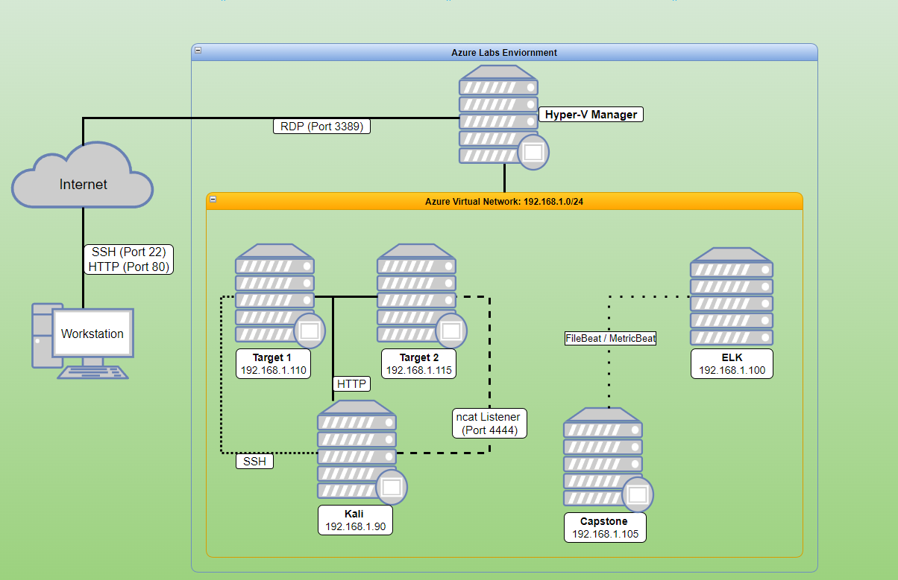
Network Topology
Network
Address Range: 192.168.1.0/24
Netmask: 255.255.225.0
Gateway: 192.168.1.1
Machines
IPv4: 192.168.1.90
OS: Linux
Hostname: Kali
IPv4: 192.168.1.100
OS: Linux
Hostname: ELK
IPv4: 192.168.1.105
OS: Linux
Hostname: Capstone
IPv4: 192.168.1.110
OS: Linux
Hostname: Target 1
IPv4: 192.168.1.1
OS: Windows 10
Hostname: ML-REFVM-684427
Notes:
Anthony

Slide 5
Critical Vulnerabilities: Target 1
Our assessment uncovered the following critical vulnerabilities in Target 1.
Vulnerability | Description | Impact
Weak Passwords | Michael’s password is michael | Was able to gain access to protected web pages
Vulnerable WordPress | Not updated, made it easy to enumerate users | Was able to find the user Michael
Unsalted Passwords | Made it easy for John to rip then R.I.P | Made it easy to gather their passwords from common word lists
Notes:
Anthony

Slide 6

Exploits Used
‹#›

Slide 7
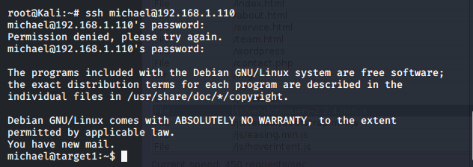
Exploitation: Weak Password
Summarize the following:
Troubleshooting the password with common password malpractices.
michael:michael (Very Weak!)
This enables the attacker to SSH into 192.168.1.110, giving access to Target 1.
Notes:
Rob

Slide 8
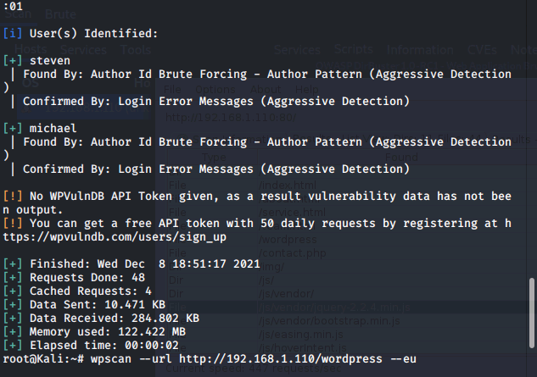
Exploitation: Vulnerable WordPress
With an outdated WordPress, attackers are able to enumerate all the users.
The Cmd to enumerate
wpscan --url 192.168.1.110/wordpress -eu
After enumeration, attacker is able to locate the user Michael.
Notes:
Tristen - WordPress uses various methods to produce a Username based on publicly accessible data. This WPScan command uses Rest API to attack the websites outdated Wordpress version, which allows us to enumerate its users.

Slide 9
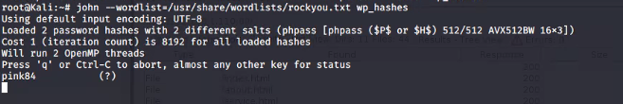

Exploitation: Unsalted Passwords
John the Ripper is able to crack unsalted passwords; using a common wordlist made it easy for John to find the password.
After John found the passwords we were able to gain access to Steven with the password pink84
PASSWORDS
Notes:
Zach The Butter Claimer

Slide 10

Avoiding Detection
‹#›

Slide 11
Stealth Exploitation of Vulnerable Wordpress
Monitoring Overview
Which alerts detect this exploit?
WHEN count() GROUPED OVER top 5 'http.response.status_code' IS ABOVE 400 FOR THE LAST 5 minutes
Which metrics do they measure?
http.response.status_code (Excessive HTTP Errors)
Which thresholds do they fire at?
Above 400
Mitigating Detection
How can you execute the same exploit without triggering the alert?
Spread out the time of the attack, 50 attempts in 1 minute.
Notes:
Scott:

Slide 12
Stealth Exploitation of Local File Inclusion (LFI)
Monitoring Overview
Which alerts detect this exploit?
WHEN sum()OF http.request.bytes OVER all documents IS ABOVE 3500 FOR THE LAST 30 seconds
Which metrics do they measure?
http.request.bytes
Which thresholds do they fire at?
Above 3500
Mitigating Detection
How can you execute the same exploit without triggering the alert?
Limit size of gathering less than 3500 bytes every 30 seconds

Slide 13
Stealth Exploitation of Directory Exploration
Monitoring Overview
Which alerts detect this exploit?
WHEN max() OF system.process.cpu.total.pct OVER all documents IS ABOVE 0.5 FOR THE LAST 5 minutes
Which metrics do they measure?
system.process.cpu.total.pct (Total CPU Usage)
Which thresholds do they fire at?
0.5 (50%)
Mitigating Detection
How can you execute the same exploit without triggering the alert?
Utilizing Google Dorking to find “invisible” directories and/or text documents that can provide information without setting off any alarms.

Slide 14

Fin

